Slide 1
DSIP – Lecturer 10 Image Enhancement in the Spatial Domain

Slide 2
Topics
Histogram Specification
Problems

Slide 3
Image Statistics
The image mean:
Generally:
The image s.t.d. :
0.25
0.2
0.15
0.1
0.05
0
1
2
3
4
5
6
7
8
9
10
gray level

Slide 4
Image Entropy
The image entropy specifies the uncertainty in the image values.
Measures the averaged amount of information required to encode the image values.
Entropy of a 2 values variable

Slide 5
Image Mean
I
x
I
I_{NEW}(x,y)=I(x,y)-b
x

Slide 6
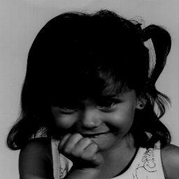
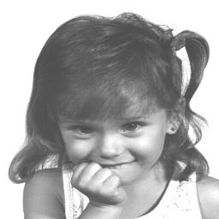
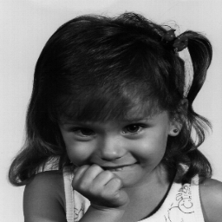
Changing the image mean

Slide 7
Histogram Usage
Digitizing parameters
Measuring image properties:
Average
Variance
Entropy
Contrast
Area (for a given gray-level range)
Threshold selection
Image distance
Image Enhancement
Histogram equalization
Histogram stretching
Histogram matching

Slide 8
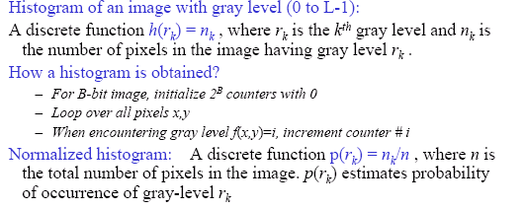
Histograms

Slide 9
Histogram
Normalized Histogram
Accumulated Histogram

Slide 10
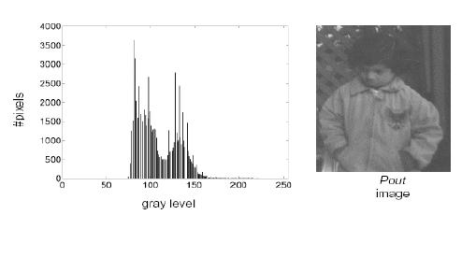
Example Histogram

Slide 11
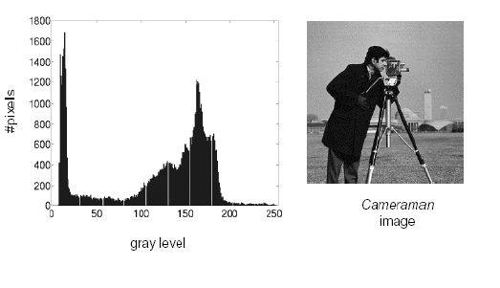
Example Histogram

Slide 12
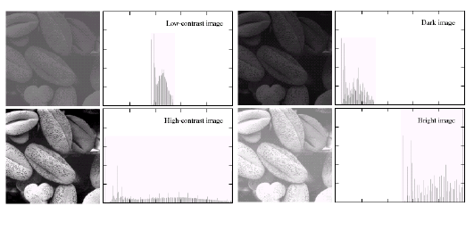
Histogram Examples

Slide 13
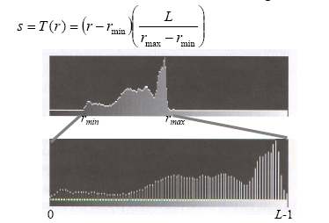
Contrast Stretching through Histogram
If r_{max} and r_{min} are the maximum and minimum gray level of the input image and L is the total gray levels of output image The transformation function for contrast stretching will be

Slide 14
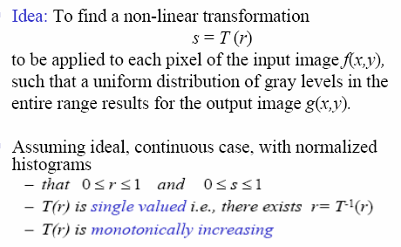
Histogram Equalization
14

Slide 15
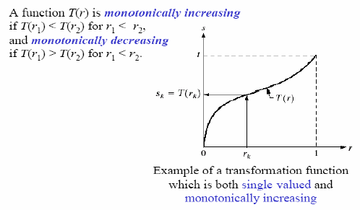
Histogram Equalization
15

Slide 16
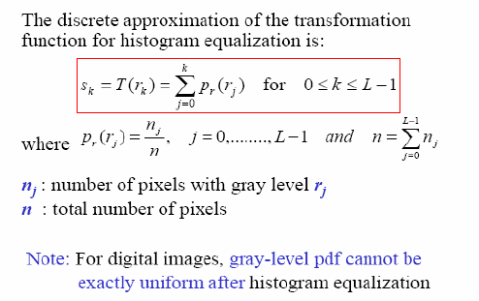
Histogram Equalization
16

Slide 17
Histogram Equalization
Spreading out the frequencies in an image (or equalising the image) is a simple way to improve dark or washed out images
The formula for histogram equalisation is given where
r_{k}: input intensity
s_{k}: processed intensity
k: the intensity range (e.g 0.0 – 1.0)
n_{j}: the frequency of intensity j
n: the sum of all frequencies
17

Slide 18
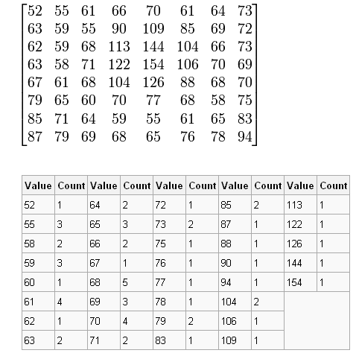
Histogram Equalization: Example
18

Slide 19
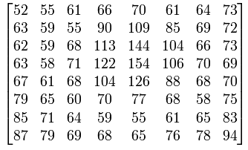
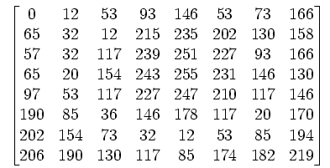
Histogram Equalization: Example
Initial Image
Image After Equalization
19
Notice that the minimum value (52) is now 0 and the maximum value (154) is now 255.

Slide 20
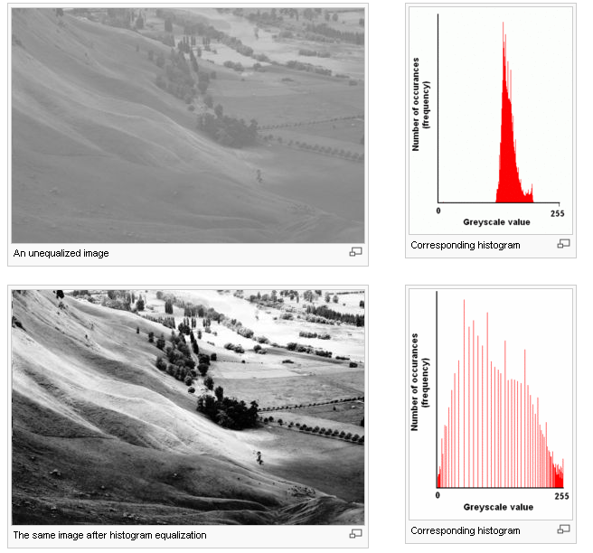
Histogram Equalization: Example
20

Slide 21
Histogram Equalization: Example
No. of pixels
6
2 | 3 | 3 | 2
4 | 2 | 4 | 3
3 | 2 | 3 | 5
2 | 4 | 2 | 4
5
4
3
2
1
Gray level
4x4 image
0
1
2
3
4
5
6
7
8
9
Gray scale = [0,9]
histogram
21

Slide 22
Histogram Equalization: Example
Gray Level(j) | 0 | 1 | 2 | 3 | 4 | 5 | 6 | 7 | 8 | 9
No. of pixels | 0 | 0 | 6 | 5 | 4 | 1 | 0 | 0 | 0 | 0
 | 0 | 0 | 6 | 11 | 15 | 16 | 16 | 16 | 16 | 16
 | 0 | 0 | 6 / 16 | 11 / 16 | 15 / 16 | 16 / 16 | 16 / 16 | 16 / 16 | 16 / 16 | 16 / 16
s x 9 | 0 | 0 | 3.3 ≈3 | 6.1 ≈6 | 8.4 ≈8 | 9 | 9 | 9 | 9 | 9
22

Slide 23
Histogram Equalization: Example
No. of pixels
6
3 | 6 | 6 | 3
8 | 3 | 8 | 6
6 | 3 | 6 | 9
3 | 8 | 3 | 8
5
4
3
2
1
Output image
0
1
2
3
4
5
6
7
8
9
Gray scale = [0,9]
Gray level
Histogram equalization
23

Slide 24
Histogram Matching
Histogram matching (histogram specification)
—A processed image has a specified histogram

Slide 25
Histogram Matching

Slide 26
Histogram Matching: Procedure
Obtain p_{r}(r) from the input image and then obtain the values of s
Use the specified PDF and obtain the transformation function G(z)
Mapping from s to z

Slide 27
Histogram Matching: Example
Assuming continuous intensity values, suppose that an image has the intensity PDF
Find the transformation function that will produce an image whose intensity PDF is

Slide 28
Histogram Matching: Example
Find the histogram equalization transformation for the input image
Find the histogram equalization transformation for the specified histogram
The transformation function

Slide 29
Histogram Matching: Discrete Cases
Obtain p_{r}(r_{j}) from the input image and then obtain the values of s_{k}, round the value to the integer range [0, L-1].
Use the specified PDF and obtain the transformation function G(z_{q}), round the value to the integer range [0, L-1].
Mapping from s_{k} to z_{q}

Slide 30
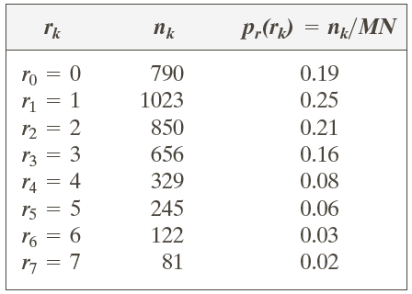
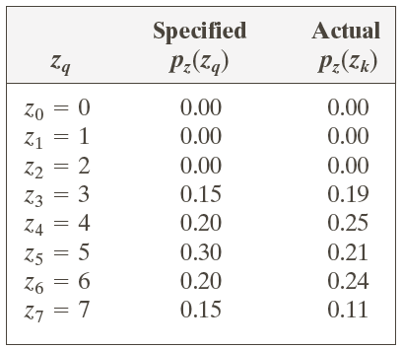
Example: Histogram Matching
Suppose that a 3-bit image (L=8) of size 64 × 64 pixels (MN = 4096) has the intensity distribution shown in the following table (on the left). Get the histogram transformation function and make the output image with the specified histogram, listed in the table on the right.

Slide 31
Example: Histogram Matching
Obtain the scaled histogram-equalized values,
Compute all the values of the transformation function G,

Slide 32
Example: Histogram Matching

Slide 33
Example: Histogram Matching
Obtain the scaled histogram-equalized values,
Compute all the values of the transformation function G,
s₀
s₁
s₂
s₃
s₄
s₅
s₆
s₇

Slide 34
Example: Histogram Matching

Slide 35
Example: Histogram Matching

Slide 36
Example: Histogram Matching

Slide 37
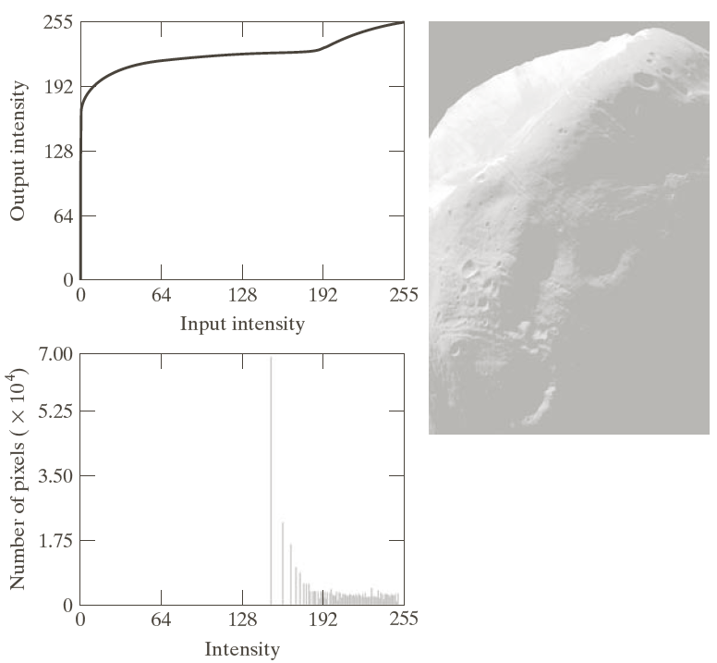
Example: Histogram Matching

Slide 38
